Slide 1
Why Functional Programming Matters
Frank vasquez

Slide 2
Overview
Who is this guy?
Misconceptions
What is this strange language?
Gluing functions together
Gluing programs together
Why now?

Slide 3

John Hughes
Trinity College, Cambridge
Oxford PhD
Chalmers University
Haskell
QuickCheck
QuviQ
Erlang

Slide 4
Less is not more
Omitting features can’t make a language more powerful.
Lack of side-effects cannot account for order of magnitude reduction in LOC.
goto structured programming analogy
Modular programs are easier to code, extend and test.

Slide 5
Good glue
“A chair can be made quite easily by making the parts - seat, legs, back etc. and sticking them together in the right way. But this depends on an ability to make joints and wood glue. Lacking that ability, the only way to make a chair is to carve it in one piece out of a solid block of wood, a much harder task.”
2 new kinds of glue: high-order functions & lazy evaluation

Slide 6
Miranda
listof X ::= nil | cons X (listof X)
[] means nil
[1] means cons 1 nil
[1,2,3] means cons 1 (cons 2 (cons 3 nil))
sum nil = 0
sum (cons num list) = num + sum list

Slide 7
Gluing functions together
reduce f a
Replaces all occurrences of cons in a list by f, and all occurrences of nil by a.
copy = reduce cons nil
sum = reduce add 0
sum [1,2,3]
cons 1 (cons 2 (cons 3 nil))
add 1 (add 2 (add 3 0))
6

Slide 8
Append
append a b = reduce cons b a
append [1,2] [3,4]
reduce cons [3,4] [1,2]
(reduce cons [3,4]) (cons 1 (cons 2 nil))
cons 1 (cons 2 [3,4]))
[1,2,3,4]

Slide 9
Datatypes
treeof X ::= node X (listof (treeof X))
node 1
(cons (node 2 nil)
(cons (node 3
(cons (node 4 nil) nil))
nil))

Slide 10
Reduce Tree
redtree f g a (node label subtrees) =
f label (redtree’ f g a subtrees)
redtree’ f g a (cons subtree rest) =
g (redtree f g a subtree) (redtree’ f g a rest)
redtree’ f g a nil = a

Slide 11
Labels
labels = redtree cons append nil
cons 1
(append (cons 2 nil)
(append (cons 3
(append (cons 4 nil) nil))
nil))
[1,2,3,4]

Slide 12
Map Tree
(f . g) x = f (g x) (node . f) x = node (f x)
maptree f = redtree (node . f) cons nil
node (f 1)
(cons (node (f 2) nil)
(cons (node (f 3)
(cons (node (f 4) nil) nil))
nil))

Slide 13
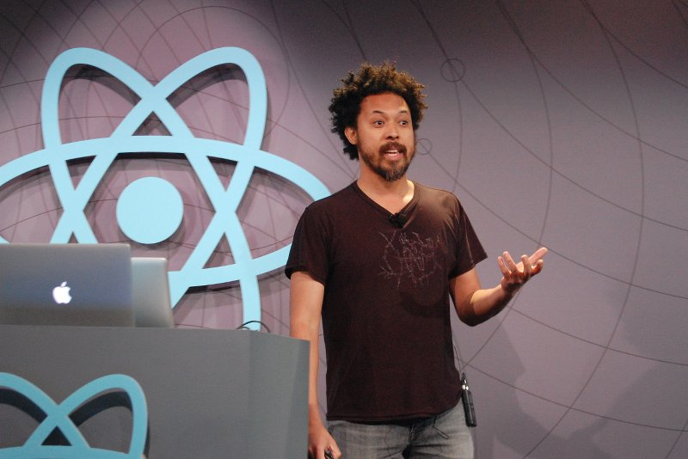
Simplicity & Performance
Underscore
React
unidirectional dataflow
Om
Flux
Mori
Immutable

Slide 14
Gluing programs together
(g . f)
g (f input)
“F is only started once g tries to read some input, and only runs for long enough to deliver the output g is trying to read. Then f is suspended and g is run until it tries to read another input. As an added bonus, if g terminates without reading all of f’s output then f is aborted.”

Slide 15
Square Roots
Newton Raphson algorithm:
Start with an initial approximation a0.
Compute better and better approximations based on previous.
Stop when approximations differ by less than a tolerance eps.
sqrt a0 eps N = within eps (repeat (next N) a0)

Slide 16
Generator
Generate a list of approximations.
repeat f a = cons a (repeat f (f a))
[a, f a, f(f a), f(f(f a)), …]
next N x = (x + N/x) / 2
repeat (next N) a0

Slide 17
Selector
“[T]akes a tolerance and a list of approximations and looks down the list for two successive approximations that differ by no more than the given tolerance.”
within eps (cons a (cons b rest)) =
= b, if abs(a-b) <= eps
= within eps (cons b rest), otherwise

Slide 18
Streams
Lisp thunks
ECMAScript Harmony
yield
generators
coroutines
callback hell
Koa

Slide 19
Credits
It’s Raining Haskell
an interview with Simon Peyton-Jones & John Hughes
http://channel9.msdn.com/Blogs/Charles/YOW-2011-Simon-Peyton-Jones-and-John-Hughes-Its-Raining-Haskell
Erlang Factory 2015 Panel Discussion
José Valim, Robert Virding, John Hughes & Guido van Rossum
http://www.youtube.com/watch?v=oZwfi8JZ3kU

Slide 20
More Credits
Immutability: Putting the Dream Machine to Work
by David Nolen
https://www.youtube.com/watch?v=SiFwRtCnxv4
Immutable Data in React & Flux
by Lee Byron
http://www.youtube.com/watch?v=I7IdS-PbEgI

Slide 21
Final Credits
Callbacks vs Coroutines
by TJ Holowaychuk
http://medium.com/@tjholowaychuk/callbacks-vs-coroutines-174f1fe66127

